Slide 1


Interim Presentation - ZakaatIQ
<Wissam Hadjarab>
<C21404706>
<TU858/4>
Supervisor:
<Supervisor Name – Mariana Rocha
1
Notes:
4

Slide 2
Introduction
ZakaatIQ is an AI-powered Islamic financial assistant that helps Muslims track income, savings, assets and debts, determine Zakat eligibility, and receive personalized lifestyle-based guidance such as marital status and dependents.
The system combines machine-learning prediction models, secure encrypted data handling, financial forecasting, and integrated links to verified Islamic charities to provide an ethical, end-to-end platform for fulfilling Zakat obligations.
2
Notes:
5

Slide 3
Similar software and their limitations
Islamic Relief Zakat Calculator – one-time manual calculation with no tracking, forecasting, or security.
National Zakat Foundation (NZF) – UK-based calculator with Nisab checking but no AI, personalization, or data storage.
Zakatify (USA) – focuses on donating Zakat, not eligibility or financial tracking
Zoya Finance – halal investment screening with a simple Zakat tool, not lifestyle-based guidance.
YNAB / Mint – strong financial tracking but interest-based and not Shariah-compliant.
3
Notes:
6

Slide 4
Academic Insight
Afar & Ali (2025) – Highlighted the lack of strong Shariah-compliant AI guidelines in Islamic finance.
Laylo (2023) – Discussed automation in Zakat platforms and the need for trust, fairness, and ethical design.
Iqbal et al. (2025) – Examined the potential risks of AI misuse in Islamic financial systems without ethical safeguards.
Deloitte (2023) – Insights on how AI improves user engagement in budgeting and financial apps.
4
Notes:
6

Slide 5
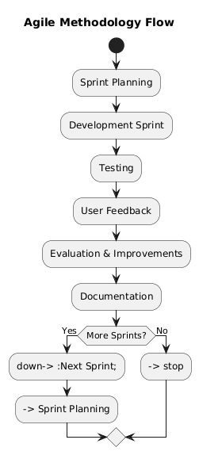
Methodology
The project follows an adapted Agile methodology, using short feature-focused sprints, iterative development, and continuous testing.
5
Notes:
7

Slide 6
Technologies
OS: macOS + mobile devices for testing
Languages: Python (backend/ML), JavaScript (frontend)
Database: PostgreSQL (+ SQLite)
Frameworks/Tools: Flask, VS Code, GitHub, Bootstrap
AI & Data: Scikit-learn, Prophet/Statsmodels, Pandas, NumPy, Matplotlib
Security: Cryptography (Fernet encryption)
Donations: Stripe
6
Notes:
8

Slide 7
Requirements
Requirements were gathered through a survey distributed to Muslims in mosques, universities, and families, identifying struggles with Zakat calculation, tracking savings, and understanding Zakatable wealth.
Stakeholder inputs included Muslim individuals, families, self-employed users, Islamic charities, scholars, and system developers.
7
Notes:
Here is a clean, concise slide covering both points, **strictly based on the document**:
---
### **Requirements & Analysis**
**Where the Requirements Came From**
* Requirements were gathered through a survey distributed to Muslims in mosques, universities, and families, identifying struggles with Zakat calculation, tracking savings, and understanding Zakatable wealth.
* Stakeholder inputs included Muslim individuals, families, self-employed users, Islamic charities, scholars, and system developers.
**Analysis Approach to Creating the Design**
* The design was shaped by translating survey results, stakeholder needs, and use cases into system features such as ML prediction, encrypted data handling, forecasting, and secure donations.
* A modular client-server architecture was selected, supported by detailed workflows, requirements lists, and system models to ensure clarity, scalability, and alignment with Islamic financial principles.
---
If you want, I can also compress this into a super-short version for faster delivery.

Slide 8
System Architecture
ZakaatIQ uses a modular client–server architecture built around a Flask backend and a web-based front-end interface.
The system is structured into layers:
Frontend/UI: HTML, CSS, JavaScript, Bootstrap for forms, dashboards, and visualization.
Application Layer: Flask backend handling routing, business logic, authentication, and encryption.
AI Processing Layer: Machine-learning models for Zakat eligibility and financial forecasting.
Data Layer: PostgreSQL storing encrypted user profiles, financial data, predictions, and donation history.
The architecture supports modular development, security, scalability, and cloud deployment readiness.
8
Notes:
Here is a clear, concise slide describing the architecture, based only on your document:
---
### **Technical Architecture**
ZakaatIQ uses a **modular client–server architecture** built around a Flask backend and a web-based front-end interface.
* The system is structured into layers:
* **Frontend/UI:** HTML, CSS, JavaScript, Bootstrap for forms, dashboards, and visualisation.
* **Application Layer:** Flask backend handling routing, business logic, authentication, and encryption.
* **AI Processing Layer:** Machine-learning models for Zakat eligibility and financial forecasting.
* **Data Layer:** PostgreSQL storing encrypted user profiles, financial data, predictions, and donation history.
* The architecture supports modular development, security, scalability, and cloud deployment readiness.
---
If you want, I can compress this into fewer bullets or make a diagram-style version.

Slide 9
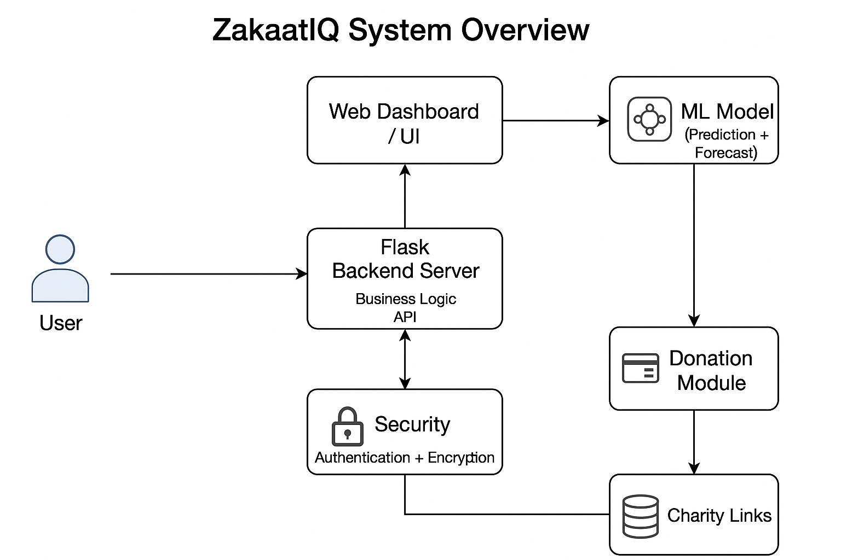
System Design Diagram
Diagram of
Technical Architecture
9
Notes:
Here is a clean, concise slide covering both points, **strictly based on the document**:
---
### **Requirements & Analysis**
**Where the Requirements Came From**
* Requirements were gathered through a survey distributed to Muslims in mosques, universities, and families, identifying struggles with Zakat calculation, tracking savings, and understanding Zakatable wealth.
* Stakeholder inputs included Muslim individuals, families, self-employed users, Islamic charities, scholars, and system developers.
**Analysis Approach to Creating the Design**
* The design was shaped by translating survey results, stakeholder needs, and use cases into system features such as ML prediction, encrypted data handling, forecasting, and secure donations.
* A modular client-server architecture was selected, supported by detailed workflows, requirements lists, and system models to ensure clarity, scalability, and alignment with Islamic financial principles.
---
If you want, I can also compress this into a super-short version for faster delivery.

Slide 10
User Flows
The user logs into ZakaatIQ and lands on their personalized dashboard.
They enter their financial and lifestyle details to check Zakat eligibility, and the ML model returns whether Zakat is required.
They then open the forecasting page, where AI generates future income and savings graphs.
If eligible, they go to the donation section, choose a verified Islamic charity, donate, and the receipt is saved to their dashboard.
When finished, the user simply logs out, closing their session securely.
10
Notes:
11

Slide 11
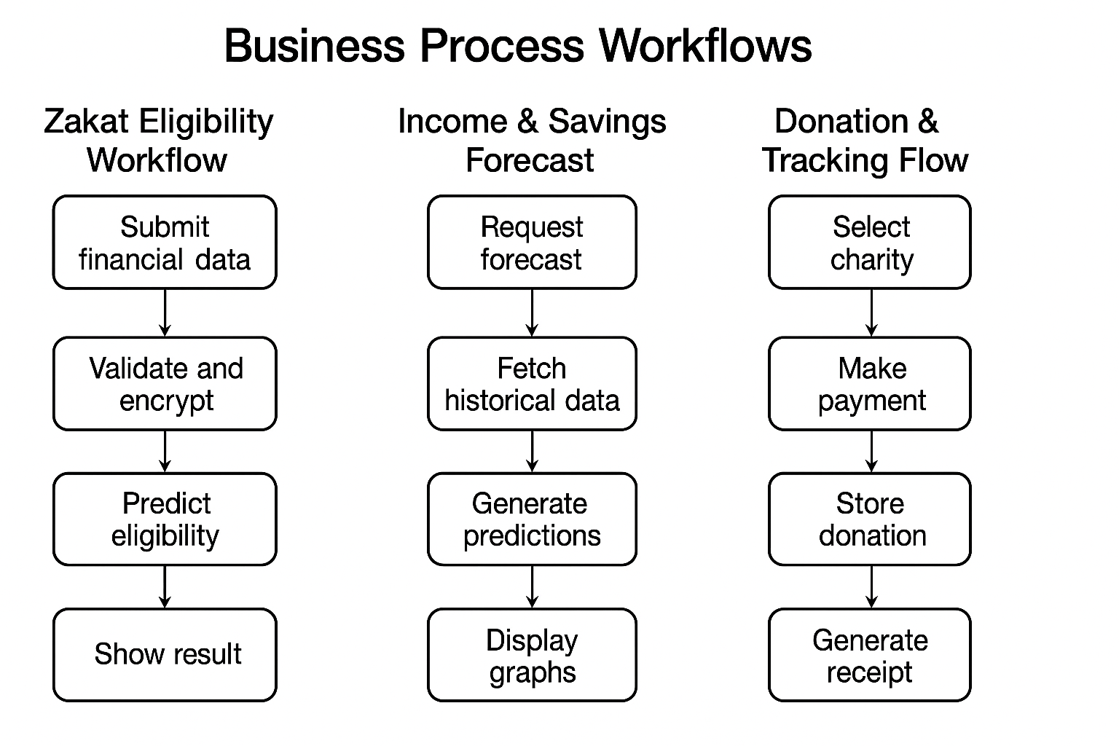
Workflows
11
Notes:
12

Slide 12
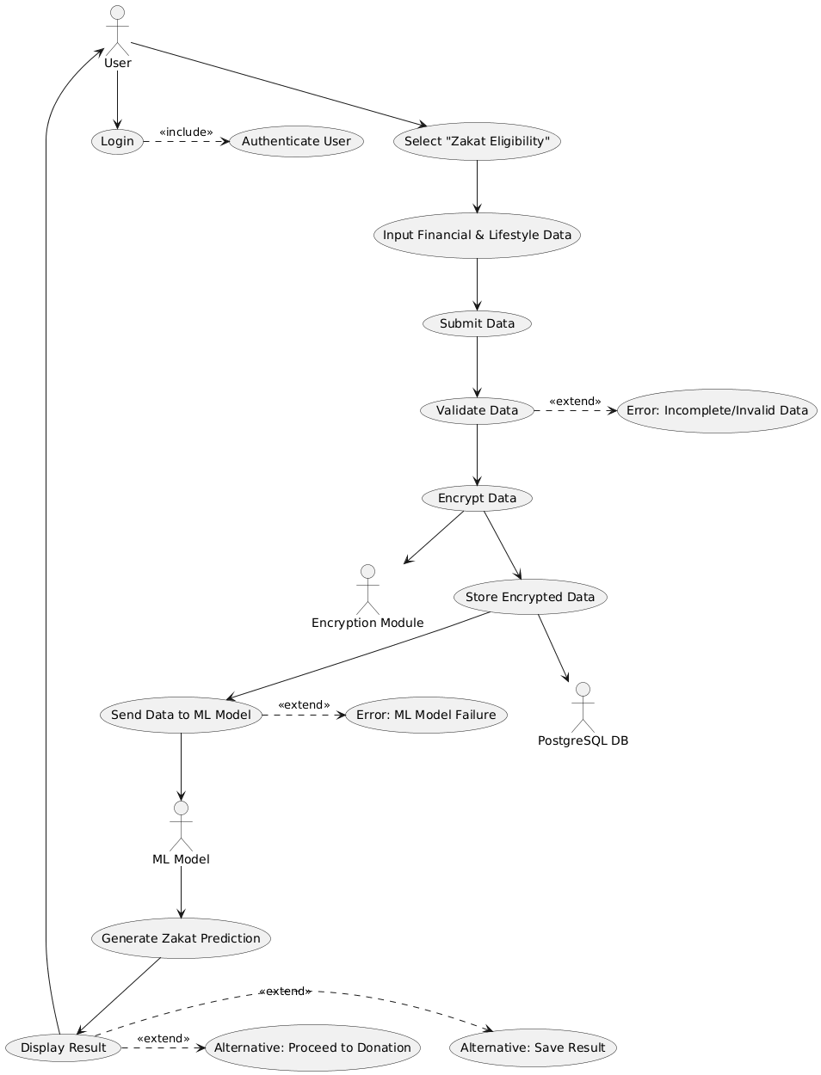
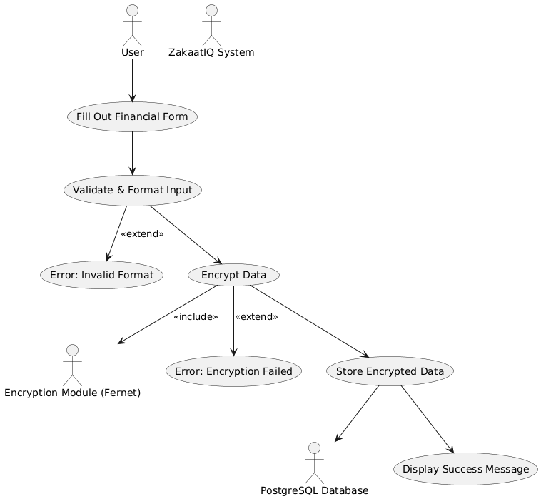
Use Cases
12
Notes:
14

Slide 13
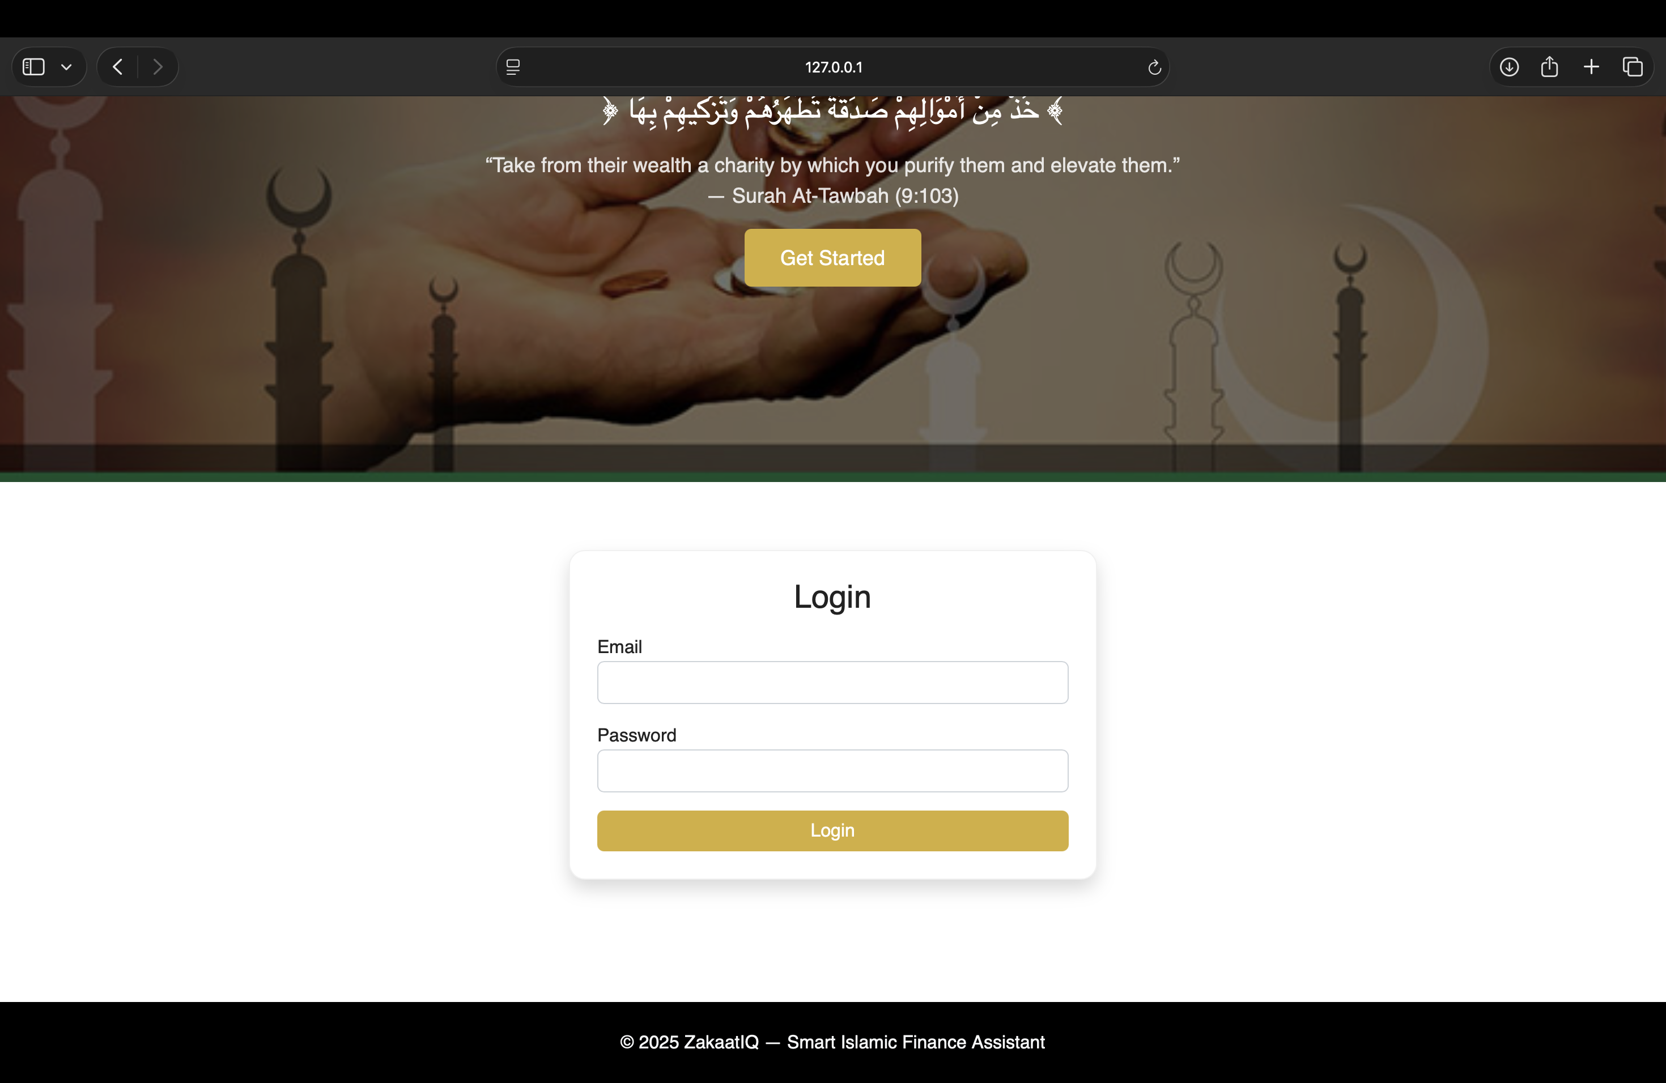
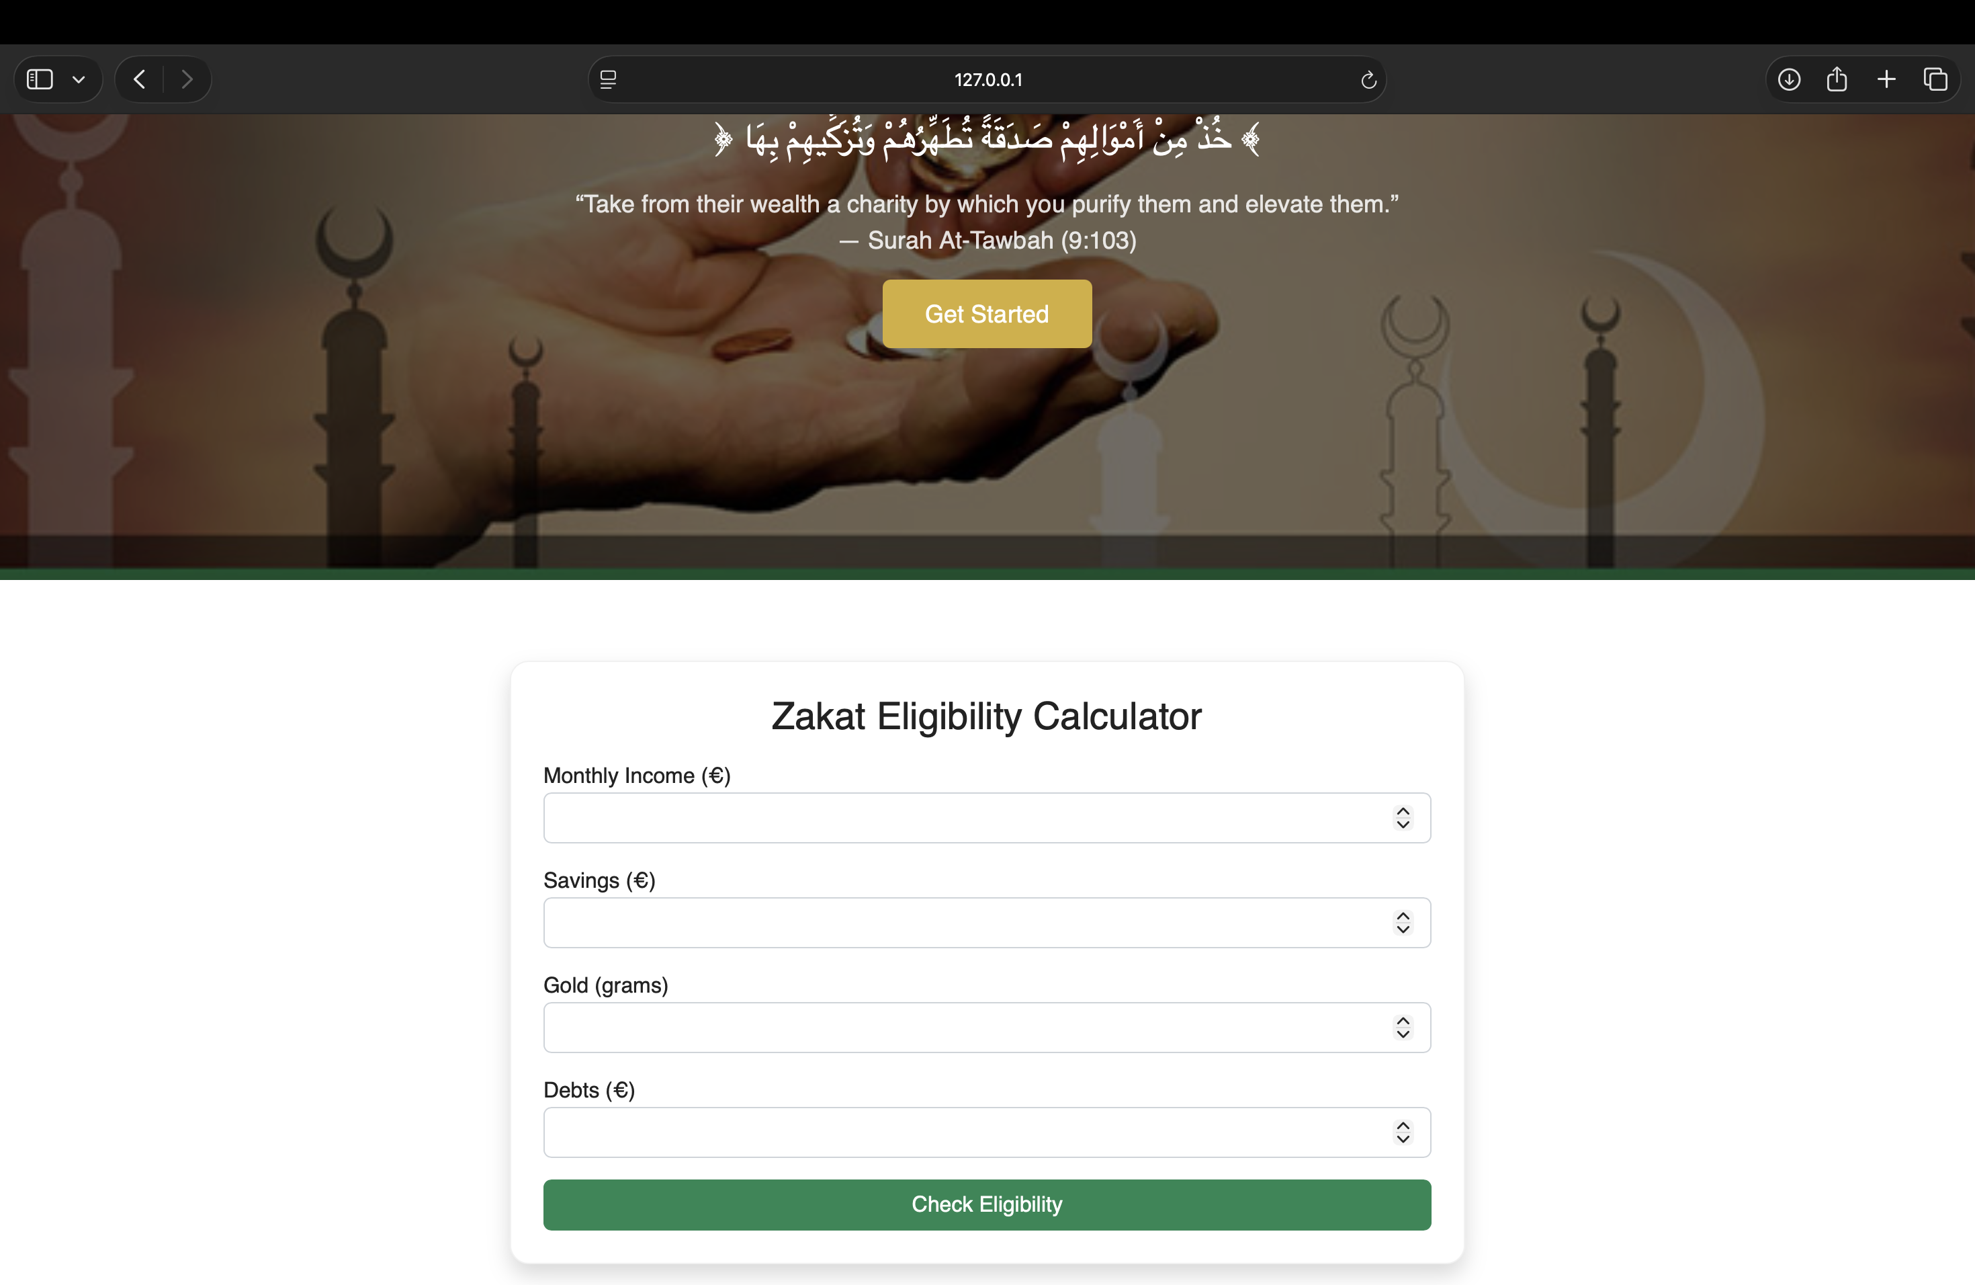
Prototype
13
Notes:
16

Slide 14
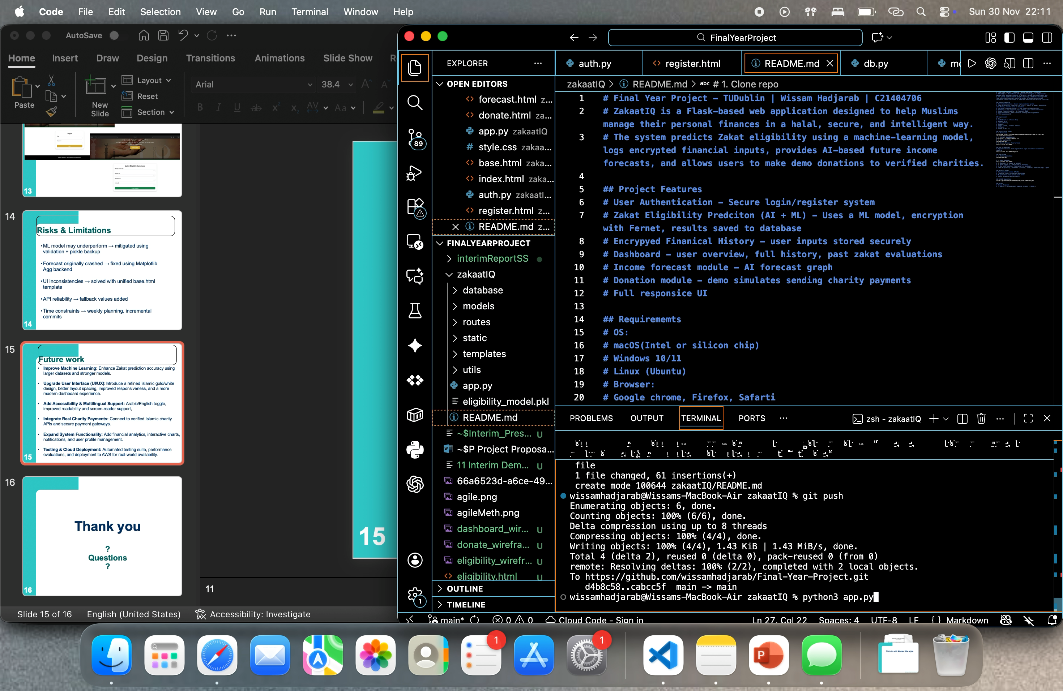
Demo
14
Notes:
16

Slide 15
Risks & Limitations
ML model may underperform → mitigated using validation + pickle backup
Forecast originally crashed → fixed using Matplotlib Agg backend
UI inconsistencies → solved with unified base.html template
API reliability → fallback values added
Time constraints → weekly planning, incremental commits
15
Notes:
11

Slide 16
Future work
Improve Machine Learning: Enhance Zakat prediction accuracy using larger datasets and stronger models.
Upgrade User Interface (UI/UX):Introduce a refined Islamic gold/white design, better layout spacing, improved responsiveness, and a more modern dashboard experience.
Add Accessibility & Multilingual Support: Arabic/English toggle, improved readability and screen-reader support,
Integrate Real Charity Payments: Connect to verified Islamic charity APIs and secure payment gateways.
Expand System Functionality: Add financial analytics, interactive charts, notifications, and user profile management.
Testing & Cloud Deployment: Automated testing suite, performance evaluations, and deployment to AWS for real-world availability.
16
Notes:
11

Slide 17
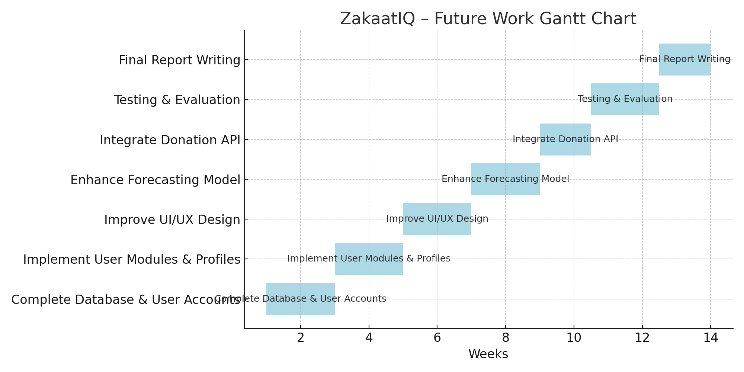
Future work
Weeks 1–3: Complete database + user accounts
Weeks 3–5: Build user profiles & polish UI/UX
Weeks 5–7: Improve forecasting model + integrate donation API
Weeks 7–10: Full system testing & bug fixes
Weeks 10–14: Final report writing & project finishing
17
Notes:
11

Slide 18
Thank you
?
Questions
?
18
Notes:
17

